Slide 1
Restaurant Recommendation system
Capstone Project Amity University

Slide 2
Objective
The objective of this competition is to build a recommendation engine to predict what restaurants customers are most likely to order from given the customer location, restaurant information, and the customer order history.
The error metric for this competition is the F1 score, which ranges from 0 (total failure) to 1 (perfect score). Hence, the closer your score is to 1, the better your model.

Slide 3
INTRODUCTION
There are several factors that influence customer decision, this case is of no difference, where the aim is to determine how various factors lead to customer selecting a particular restaurant. There are three categories of data collected i.e restaurant information, customer location and customer order history.
By selecting variables from this datasets, we draw insights using various statistical techniques which will direct in selection of suitable model, that will result to maximal accuracy of predictions

Slide 4
DATA
This data is obtained from the kaggle website;
https://www.kaggle.com/mrmorj/restaurant-recommendation-challenge
Data utilized in this case is divide into two main categories training and testing, where those sections are further divided into and each set is saved in a file
For this case the section of data utilized is orders, vendors, location and customers.

Slide 5
Cleaning the data
For this case different approaches have been used which involved removal of null values as well as outliers. Use of boxplots have been applied to detect outliers.
Using boxplot(next slide) , for example for the attribute preparation, it’s clear that there are points outside the whisker box indicating presence of outliers.
To remove outliers, approach of z-score and quantiles have been applied.

Slide 6
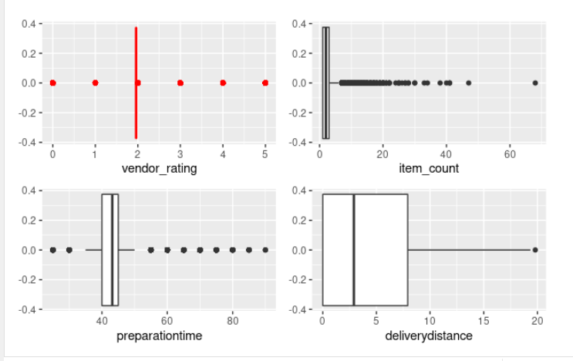

Slide 7
ANALYSIS
In this section, start by evaluating how different variables are correlated based on orders records
For the first case, evaluate relationship of vendor(restaurant) rating with vendor’s preparation time, discount amount, delivery distance and number of item bought.

Slide 8
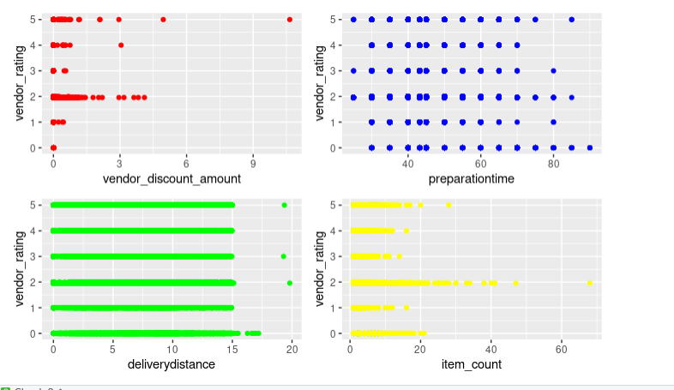

Slide 9
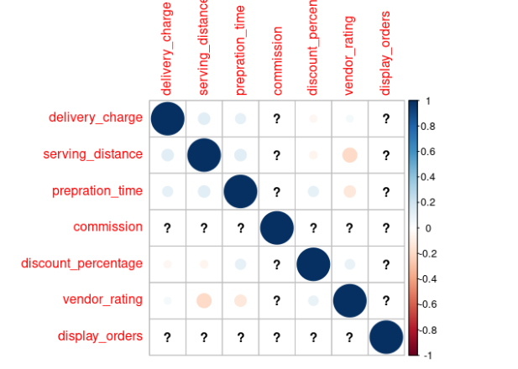

Slide 10
FOR the above corrplot , the variables selected from the vendor dataset indicate 0 correlation or minimal correlation almost zero
The scatterplot indicate poor relationship between the said variable therefore, vendor rating may not be higly influenced by vendors preparation time, delivery distance, dicount amount and number of items bought by the customer.

Slide 11
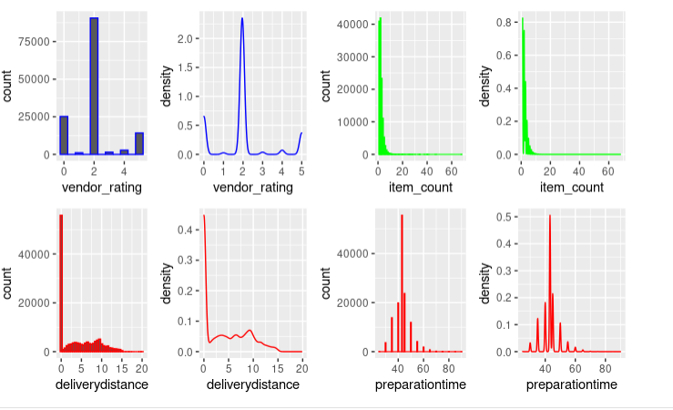
DISTRIBUTION PLOTS

Slide 12
The above plots describe how the used variabales are distributed in relation to the vendors. VFor the case of rating most vendors are rated 2, while for the case of item count is positively skewed indicating most customers buy item ranging from 0-20. Preparation time can be said to follow a normal distribution. Delivery distance plot indicate that most vendors deliver goods at a distance of 0-15.

Slide 13
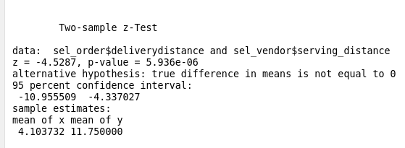
Testing Hypothesis
For this case there different cases where this approach is utilised. for the first case we test if serving distance mean is equal to that of delivery distance, where it’s important to evaluate of both mean the same or if they are equal. Where the aim is to determine whether the difference in significant. The results for the test is as follows.

Slide 14
H0: mu1=mu2
H1: mu1 not equal mu2
The second case we compare the means of variables from the full dataset (assumed to be population) to that of the dataset vendor , for example testing if the difference in mean of delivery charge is significant when two are compared.

Slide 15
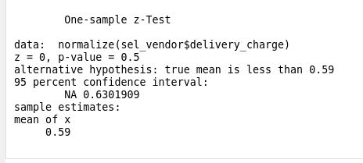
H0: mu1=mu2
H1: mu1 not equal mu2
The second case we compare the means of variables from the full dataset (assumed to be population) to that of the dataset vendor , for example testing if the difference in mean of delivery charge is significant when two are compared.

Slide 16
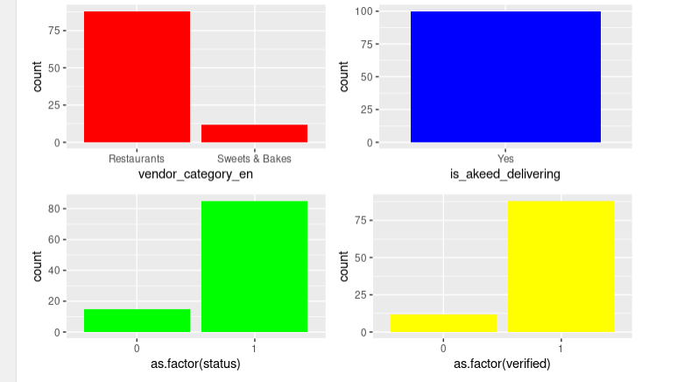
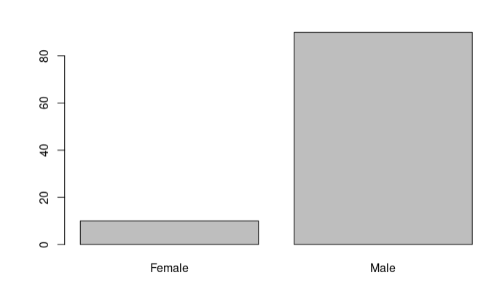
Categorical variables

Slide 17
The plot shows the number of each category in certain variable, for example in the case of vendor category the number of restaurant is high compared to that of sweet and bakes.

Slide 18
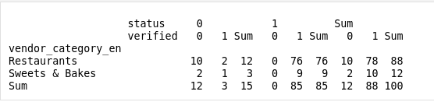
Relating categorical variables

Slide 19
For this, categorical variable can be related by grouping, for this case , it’s relating vendor catengory with both verified and status. This for example shows how many accounts in restaurants are verified. For the case of restaurants 88 are verified and 10 not.

Slide 20
Clustering
For this case , clustering based on customer location is applied using kmeans algorithm where can be used to predict the vendor category customer are likely to order from, The number of clusters selected for this case is 2.

Slide 21
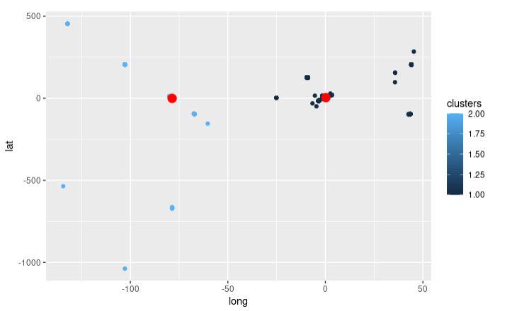
Cluster Plot

Slide 22
Classification models
For this case 2 models are applied
1. SVM
2. Naive Bayes
The results of the two algorithms using the confusion matrix is evaluated to find which model perform well when tested on new data.

Slide 23
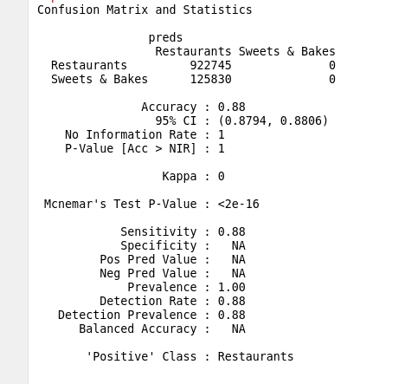
SVM Performance

Slide 24
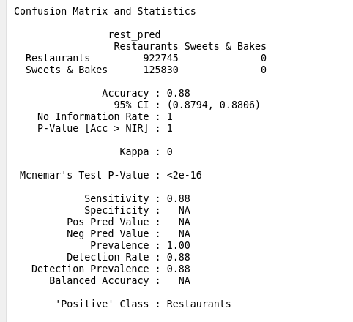
Naive Bayes performance

Slide 25
CONCLUSION
The two classification models performs well (88% accuracy) therefore can be used in classification of various targets in this case, used to clasify vaendor category, that most customers are likely to order from.
In this case vendor category assumes restaurant category, therefore able to predict the restaurant the customer is likely to order in terms of categories.

